Slide 1
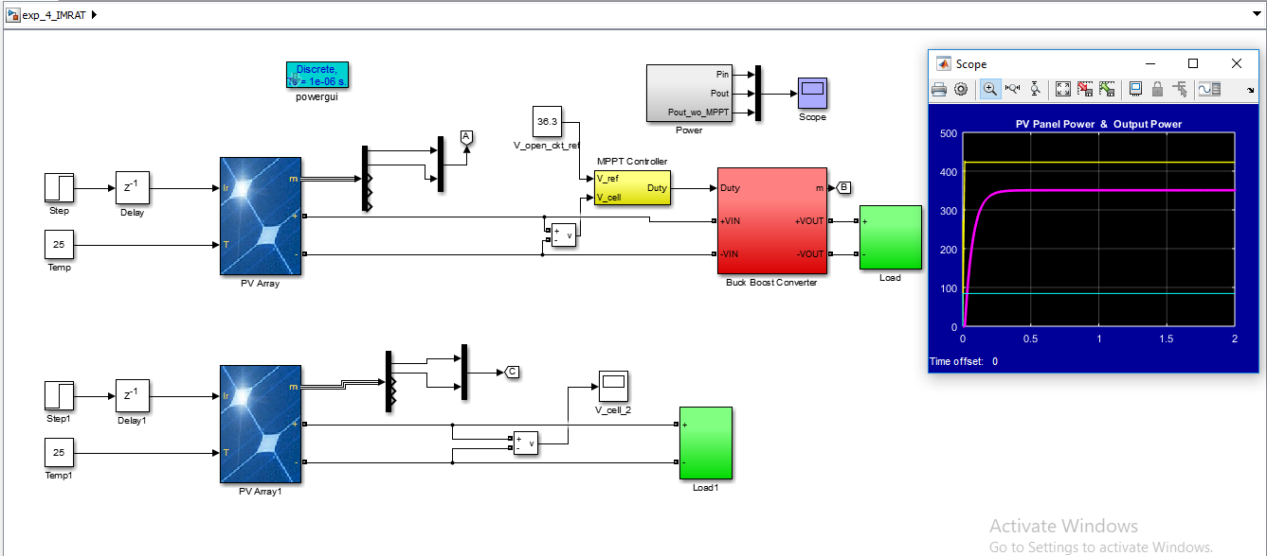
Simulink Model of Constant Voltage Based MPPT algorithm

Slide 2
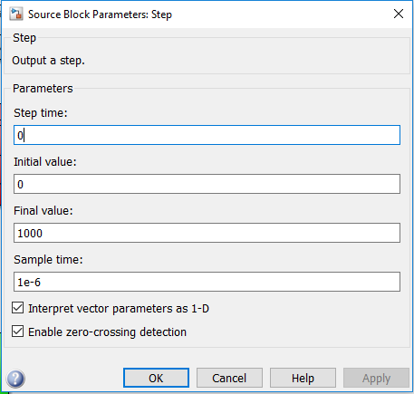
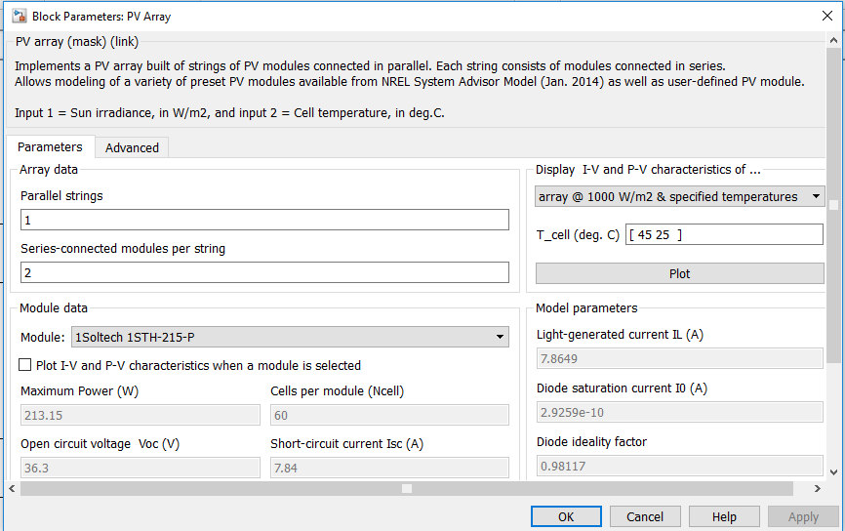
PV Array and Step Input

Slide 3
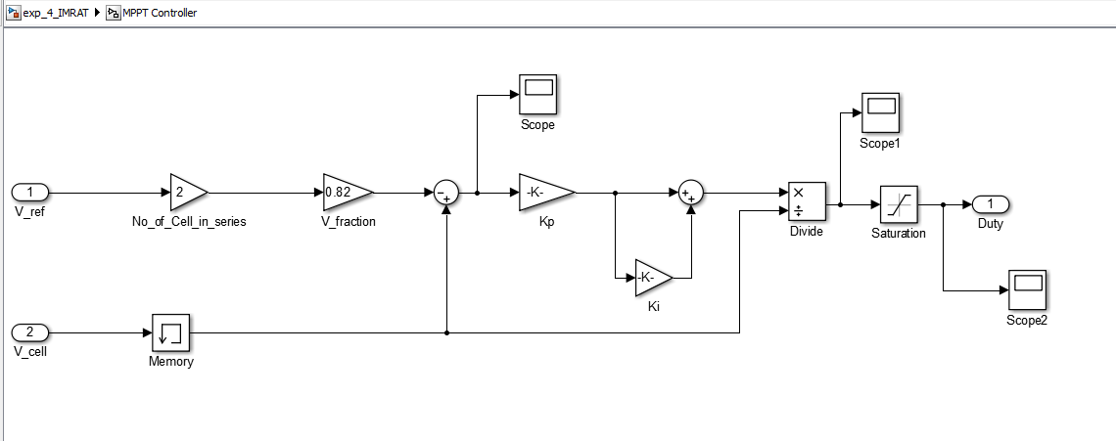
MPPT controller
Kp = 2*pi*100*47e-6 Ki = 30/(47e-6)

Slide 4
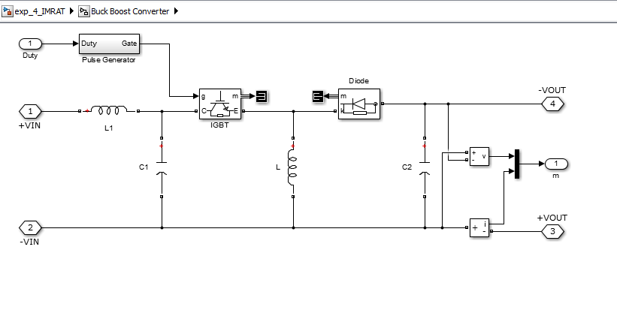
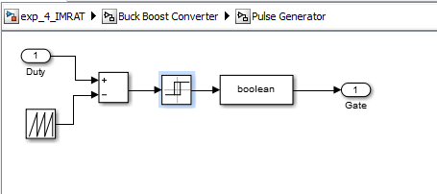
Buck Boost Converter
L = 47e-6 L1 = 1000e-6
C1 = 2000e-6 C2 = 2000e-6

Slide 5
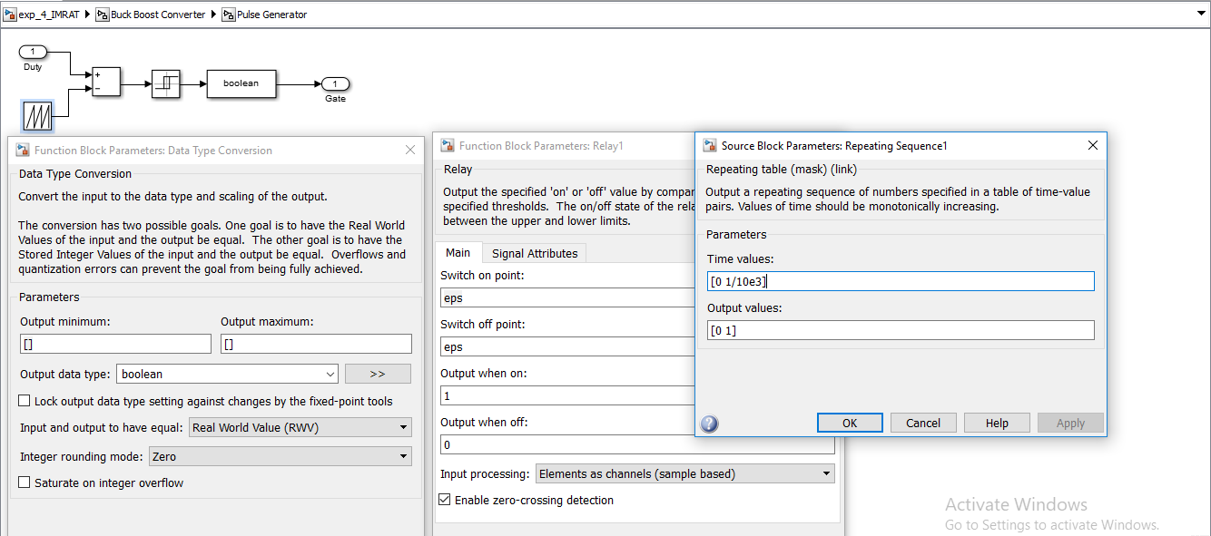
Pulse Generator

Slide 6
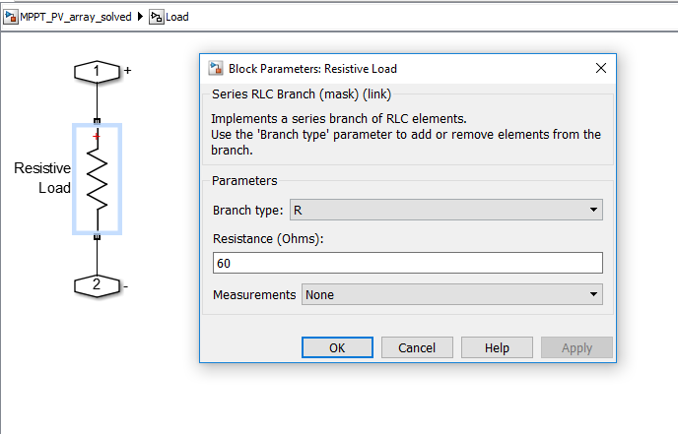
Load

Slide 7
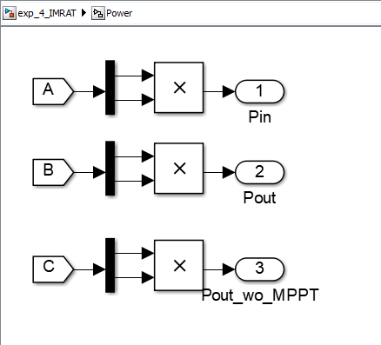
Power

Slide 8
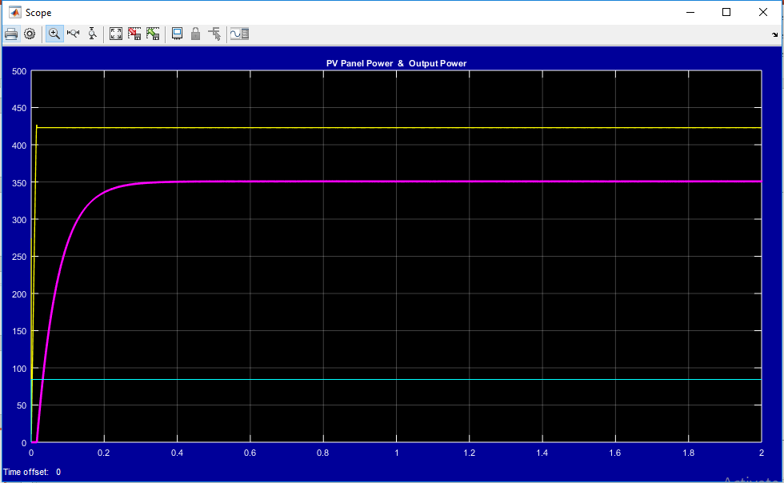
Input Power , Output power (with and without MPPT)

